Slide 1
CLASE DE INVESTIGACION APLICADA - 2012
APPLIED RESEARCH CLASS, 2012
Class Expectations:
• Be on Time (Estar a Tiempo en su Salon de Clase)
• Be Prepared (Repasar y realizar sus tareas)
• Be Ready to Discuss (Promueva la Discusion)
• Be Respectful (Comportarse con Respeto en todo tiempo)
Sociology is the study of people, social life, and society.
Sociologists attempt to understand and explain human social behavior by studying the groups to which they belong.

Slide 2
Grade breakdown:
Tests/Quizzes= 50%
Assignments=25%
Projects=25%

Slide 3
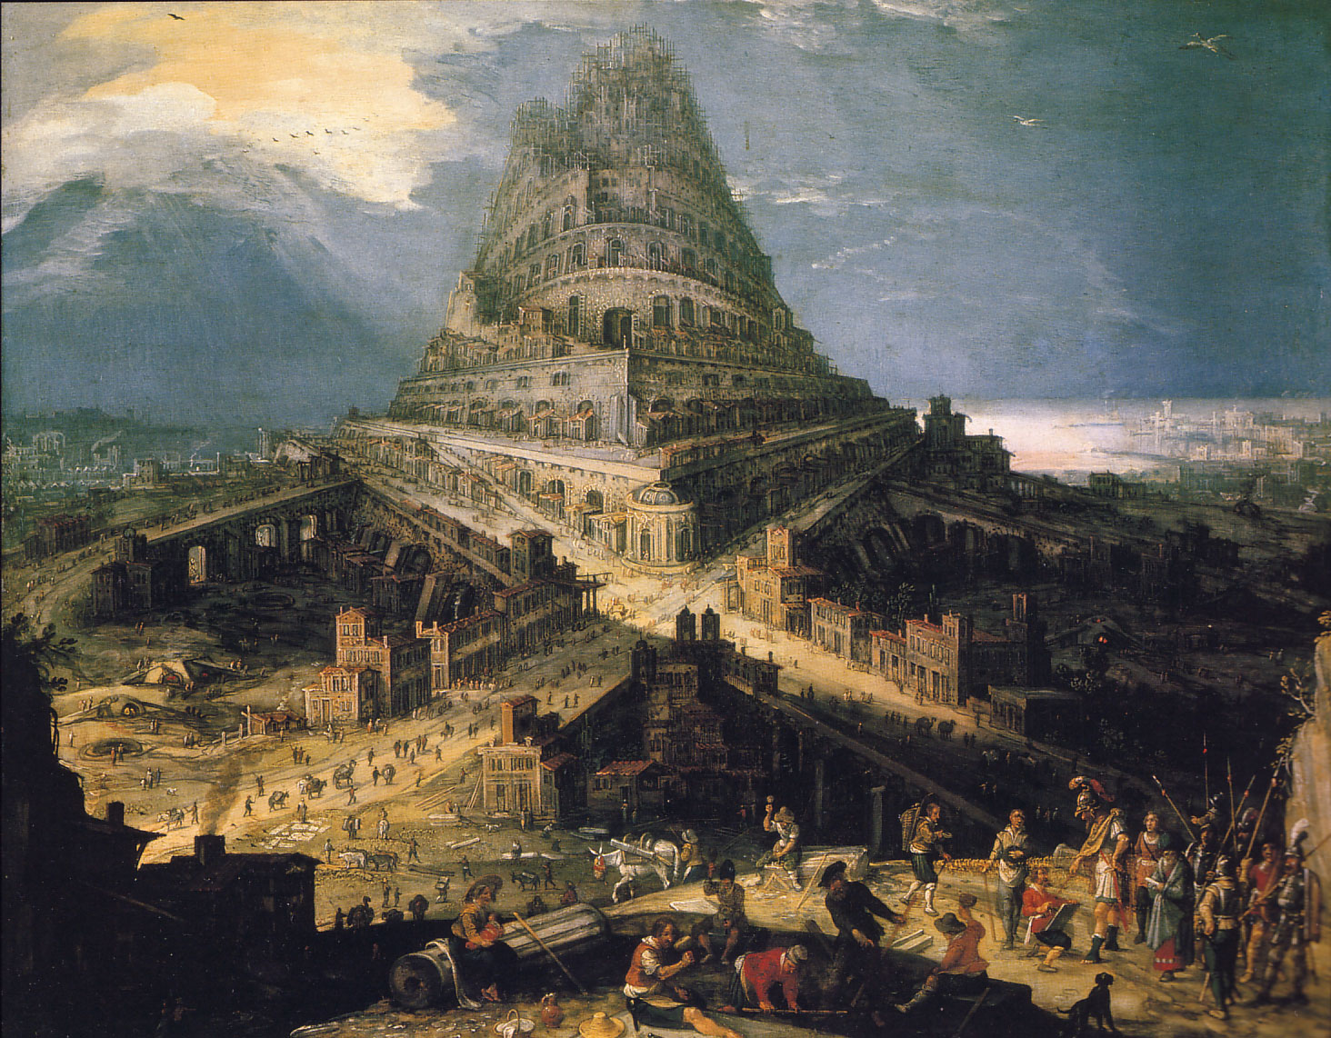
Applied Research, 2012
Now Yahweh came down to see the town and the tower that the sons of man had built. “So they are all a single people with a single language!” said Yahweh.
”This is but the start of their undertakings! There will be nothing too hard for them to do. Come, let us go down and confuse their language on the spot so that they can no longer understand one another.” Yahweh scattered them thence over the whole face of the earth, and they stopped building the town. It was named Babel therefore, because there Yahweh confused the language of the whole earth. It was from there that Yahweh scattered them over the whole face of the earth [Genesis 11: 5-9; Jerusalem Bible 1966: 141.
José Luis Ibave González, Ph.D.
FCPyS-UACH

Slide 4
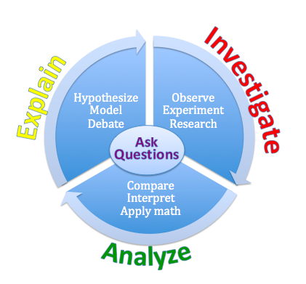
Babel becomes a metaphor for the division of the human race into groups unable to communicate with one another. Applying that metaphor to contemporary sociology, we appear to have achieved a more subtle procedure than speaking languages from different cultures.
We have learned to speak the languages of different subcultures within our discipline.
Scientific
Method

Slide 6
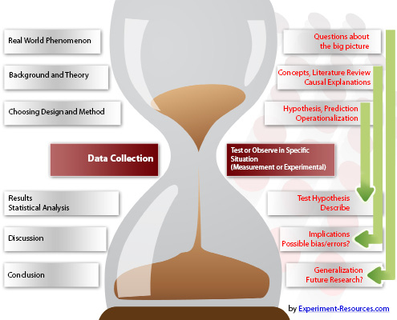

Slide 7
Published by McGraw-Hill, a business unit of The McGraw-Hill Companies, Inc., 1221 Avenue of the Americas, New York, NY 10020. Copyright © 2012

Slide 8
Scientific method and an alternative interpretation:
Traditional labeled "bureaucratic“
Centered on how the individual might ”adjust” to society in order to solve his or her problems rather
than on how society might change in response to those problems
The new approach "interactive.“
Society need not bow down to physical and biological technologies involving ”material culture.’’ Rather, it is possible for us to create the kind of society in which
those technologies move in directions that strengthen ”nonmaterial culture”.

Slide 9
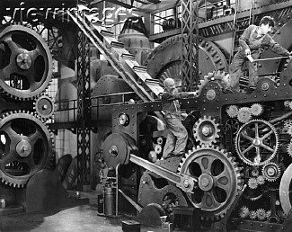
PROBLEMS WITH BUREAUCRATIC SCIENCE
Mills’s concept of the sociological imagination:
. . . that imagination is the capacity to shift from one perspective to another from the political to the psychological; from examination of a single family to comparative assessments of the national budgets of the world; from the theological school to the military establishment; from considerations of an oil industry to studies of contemporary poetry. (1959:7)

Slide 10
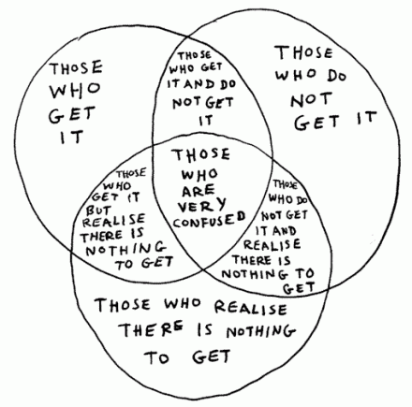
Sociological Imagination

Slide 11
The scientific method of Mills’ work suggests five components:
We should not shirk from addressing absolutely fundamental problems within society.
We should move far up language’s ladder of abstraction so as to utilize very abstract concepts.
(3) We should come far down that ladder so as to examine the concrete evidence that bears on our ideas.
(4) We should work to integrate our knowledge so that our approach is broad enough to enable us to shift from one perspective to another.
(5) We should develop ourselves as individuals with the ability to think in this broad way, developing a ”sociological imagination” that suggests a new vision of society.

Slide 12
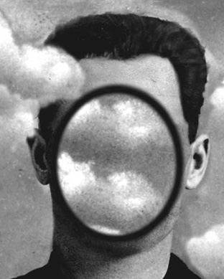
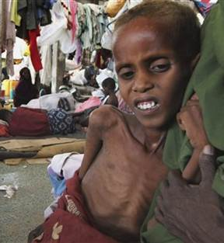
”What is happening in the social world as well as what is widely felt and widely thought can no longer be satisfactorily explained by the received principles, then an epoch is ending and a new one needs to be defined”

Slide 13
What are Social Scientists looking for?
Social theorists are concept-creators means that they are not merely in the knowledge-creating business, but also in the language-reform and language-creating business. In other words, they are from the beginning involved in creating a new culture.

Slide 14
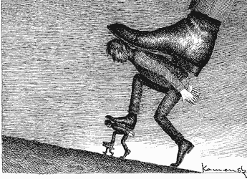
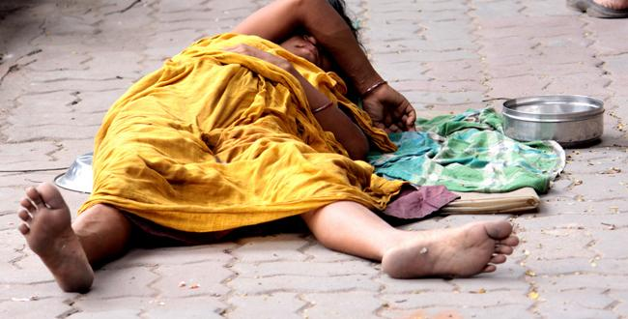
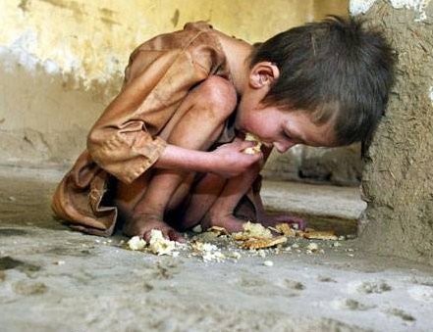
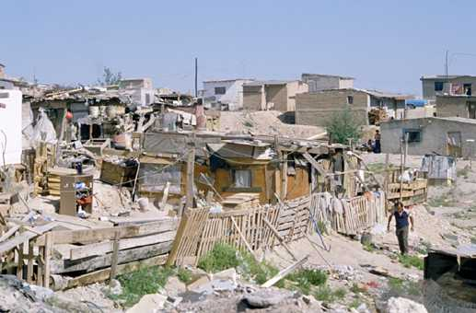
This is what we want as a new Society ! !
Can we build a better future? ?

Slide 15
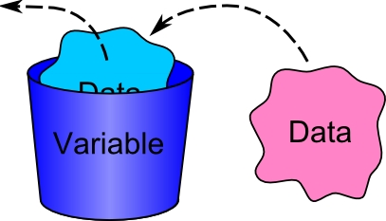
What affects Society? How do we research a Social Problem?

Slide 16
Example in Social Sciences.-
Viewing the program of birth control in terms of how it enters into the lives of people, we need to note many things such as:
the literacy of the people,
the clarity of the printed information,
the manner and extent of its distribution,
the social position of the directors of the program and of the personnel,
how the personnel act,
the character of their instructional talks,
the way in which people define attendance at birth control clinics,
the expressed views of influential personages with reference to the program,
how such persons are regarded, and
the nature of the discussions among people with regard to the clinics.
Quantitative factors

Slide 17
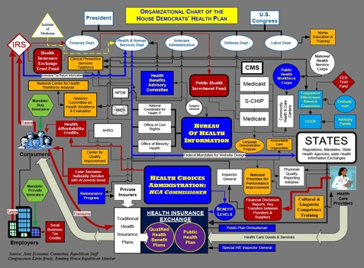
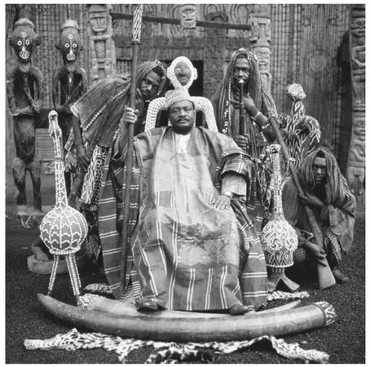
We get the whole picture from the above……. Of course NO
For example, there is the little matter of cultural values and norms as well as patterns of social organization in society as a whole like social stratification and bureaucracy.
Most of quantitative methodology pushes aside such considerations, for they would interfere with the tools of measurement that we presently have and that yield definite findings.

Slide 18
Integrating Knowledge
Analysis is the way in which all aspects of the sociologist’s usage of the scientific method are intimately tied together within the same scientific paradigm.

Slide 19
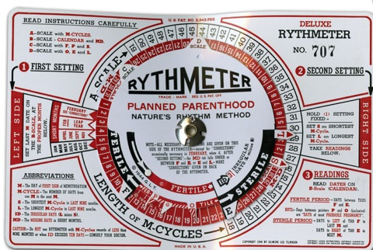
For example, we may be able to reject the null hypothesis that there is no relationship whatsoever between, say, the number of people visiting a birth control center and the birth rate of a given people. In other words, we find that the birth control program “works” at least to a very limited extent, and this has at least some utility in efforts to evaluate its effectiveness.

Slide 20
But what have we learned as a result?
Theoretically, we have learned little more about the impact of cultural values and norms, of patterns of bureaucracy and social stratification, of anomie and alienation, of patterns of conformity and deviance, of relative deprivation and reinforcement. And there appears to be little practical impact for our conclusion, since we surely did not really previously believe the null hypothesis that the birth control program had absolutely no effect on the birth rate. And what have we learned about comparing this program with many others as well as how to improve any of these programs?

Slide 21
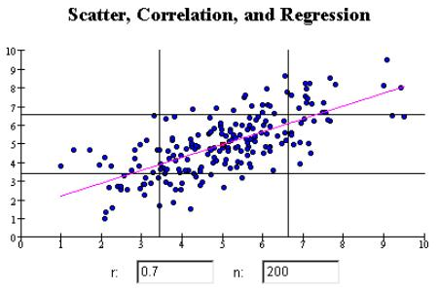
In an effort to answer at least some of these questions, quantitative analysts have utilized procedures for correlation and regression, both of which encourage precise measurement procedures.
Correlation would tell us just how much the birth rate would be affected by a birth control program
Regression would enable us to make a prediction as to the change in birth rate from our
knowledge of the existence of birth control programs.

Slide 22
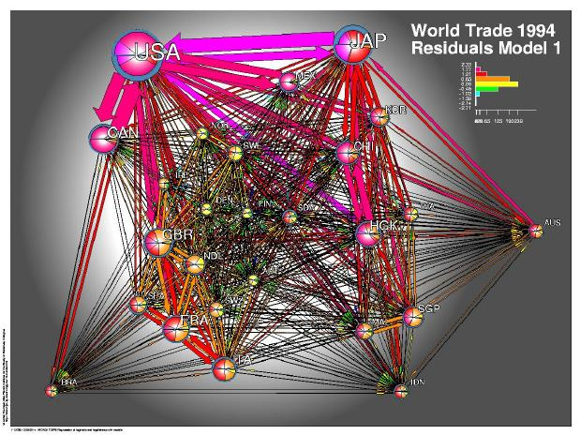
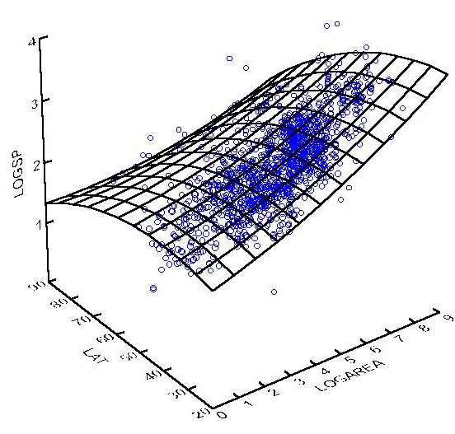
One problem, however, is that use of such more sophisticated quantitative procedures which also require more assumptions that may not hold true-does not necessarily yield high correlations or accurate predictions. Arguably, sociological efforts to correlate and predict have generally yielded low correlations and inaccurate predictions.
One response on the part of quantitative sociologists to these problems is to move further in a quantitative direction. If high correlations and accurate predictions cannot be made from knowledge of one variable, how about many variables? For example, they use such procedures as factor analysis, cluster analysis, partial and multiple correlation, multiple regression, path analysis, and discriminant analysis.

Slide 23
WE need to develop a sociology that is integrated, credible, and cumulates rapidly. Such a sociology requires us to face up to our present divorce between methods and theory.
On the doctrine of poisons- So many things have to come together for scientific thinking to originate; and all these necessary strengths had to be invented, practiced and cultivated separately. As long as they were still separate, however, they frequently had an altogether different effect than they do now that they are integrated into scientific thinking and hold each in check. Their effect was that of poisons; for example, that of the impulse to doubt, to negate, to wait, to collect, to dissolve. Many hecatombs of human beings were sacrificed before these impulses learned to comprehend their coexistence and to feel that they were all functions of one organizing force within one human being. And even now the time seems remote when artistic energies and the practical wisdom of life will join with scientific thinking to form a higher organic system in relation to which scholars, physicians, artists, and legislators-as we know them at present-would have to look like paltry relics of ancient times. ([1887] 1974:173)
Nietzsche

Slide 24
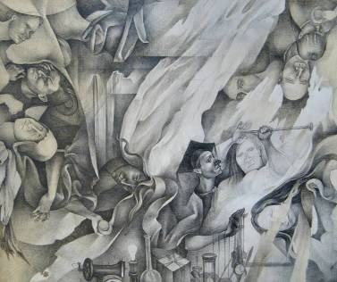
Time for mankind to understand the nature of its new situation.

Slide 25
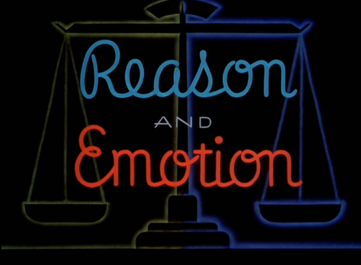
Unification of scientific method with "artistic energies and the practical wisdom of life.“ Nietzsche

Slide 26
VALUES - such as equality, freedom, democracy, science and secular rationality, and the ultimate worth of every single individual- appear to have grown stronger, not only within sociology but also throughout contemporary society.

Slide 27
A SCIENTIFIC METHOD FOR SOCIOLOGY
1. Definition of the Problem
Figure 1-1.
The invisible crisis: the escalating gap between expectations and fulfillment.

Slide 28
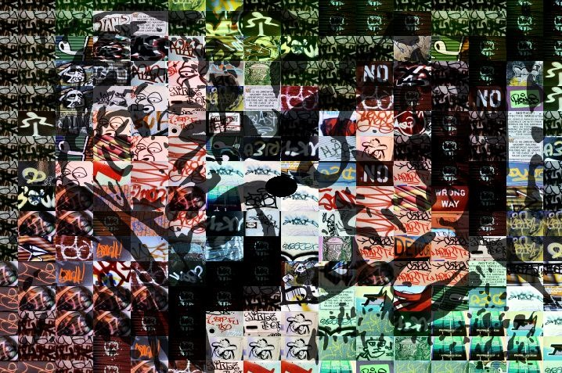
2. High Level of Abstraction
The quality of dealing with ideas rather than events. Something that exists only as an idea.
the process of formulating generalized ideas or concepts by extracting common qualities from specific examples
Concepts that are linked together systematically rather than employed in isolation from one another.

Slide 29
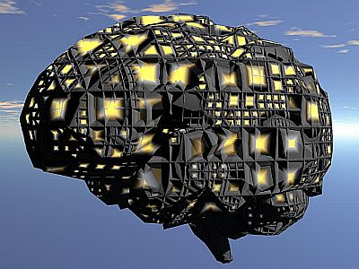
As we move down lines of longitude reaching from the North Pole to the equator within the northern hemisphere, we are also moving down language’s ladder of abstraction from concepts that are very abstract to concepts that are very concrete.
This movement works in the same way for the physical and biological sciences and the social sciences.
Concepts at a High Level of Abstraction
Physical & Biological
Science
Social Science
CONCEPTS AT A LOW LEVEL OF ABSTRACTION
Concepts at a High Level of Abstraction
Literature
Similarly, the South Pole represents a high level of abstraction for literary concepts, and movement up to the equator is movement to concepts at a low level of abstraction.

Slide 30
For example, within sociology we might move from ”social stratification”- defined broadly enough to encompass racism, classism, ageism, sexism, and ethnocentrism-to the concept of racism between blacks and whites in American society, and still further down, black-white racism within American society after the Civil War. Within physics we might have concepts like "force" at the North Pole-defined broadly enough to include the force of gravity along with mechanical and other forces-and the force of gravity of objects in free fall near the earth still further down.
Concepts at a High Level of Abstraction
Physical & Biological
Science
Social Science
No actual phenomena are depicted at the equator, but only concepts at a very low level of linguistic abstraction.
CONCEPTS AT A LOW LEVEL OF ABSTRACTION
Concepts at a High Level of Abstraction
Literature

Slide 31
Concepts at a High Level of Abstraction
Physical & Biological
Science
Social Science
CONCEPTS AT A LOW LEVEL OF ABSTRACTION
Concepts at a High Level of Abstraction
Literature
Literature, by contrast, does not emphasize technical terms but communicates with ordinary language. And ordinary language is also organized by levels of abstraction, such as "human being" at the South Pole, "men" closer to the equator, and "Hamlet" at the equator. And literature with its metaphors can illustrate the power of language to jump from the concrete to the abstract.

Slide 32
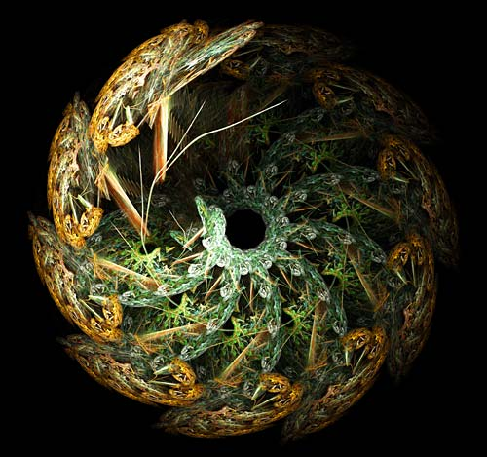
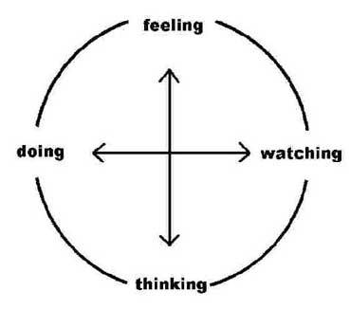
Conclusion
it is concepts at a very high level of abstraction that we sociologists desperately need if we wish to learn from the achievements of the physical and biological sciences.

Slide 33
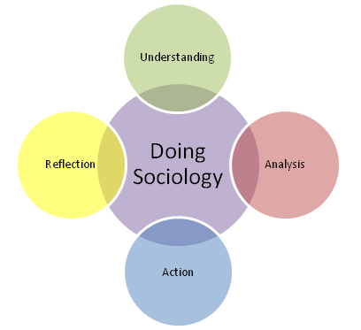
A web of sociological concepts

Slide 34
"institutions" would include "family," "educational system," "economy," "political system,“ and "religion."
"group" includes "community," "ethnic group,“ "race," and "social class." And "label" along with "social stratification“
”Occupations” are related to “bureaucracy,” ”social stratification,” and “group.” ”Role” and ”sex roles” are linked to ”norms” and ”values” as well as ”group” and ”institutions.”
"authority," "power," "caste system," and "class consciousness are linked to "social stratification" and "bureaucracy" along with the political and economic "institutions." "Ecology" is related to "physical structure'' and "population" along with "race" and "gender" to "biological structure.'' "Emotions" are linked to "values," "relative deprivation,“ "reinforcement," and "alienation." "Law" and "crime" are tied to ”norm,” “value,” ”conformity,” and ”deviance.”

Slide 35
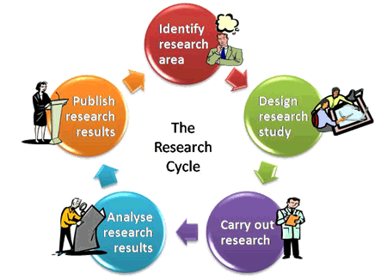
RESEARCH
Why Research Is of Value?
Ways of Knowing
Sensory Experience
Agreement with Others
Expert Opinion
Logic
The Scientific Method

Slide 36
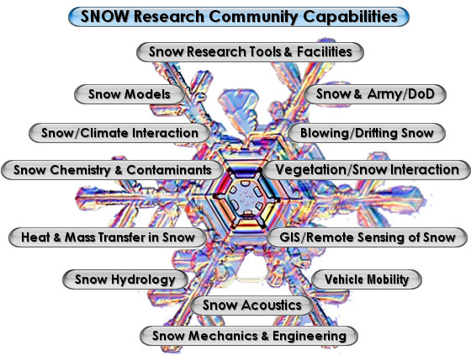
What About Social Effects?

Slide 37
Types of Research
Quantitative and Qualitative
Experimental Research
Correlational Research
Causal-Comparative Research
Survey Research
Ethnographic Research
Historical Research
Action Research
Evaluation Research

Slide 38
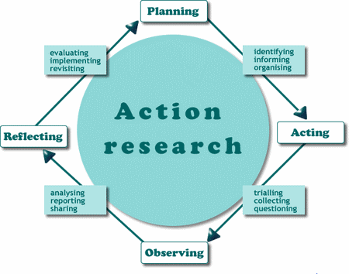

Slide 39
